Slide 1
CIS8695 Managing Big Data Analytics
Nasim Mousavi
Assistant Professor
J. Mack Robinson College of Business
Georgia State University
nmousavi@gsu.edu

Slide 2
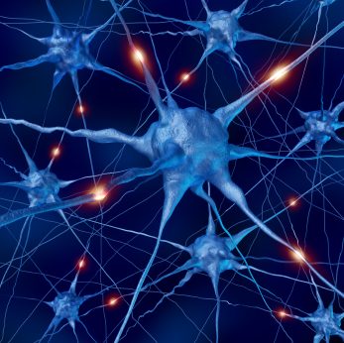
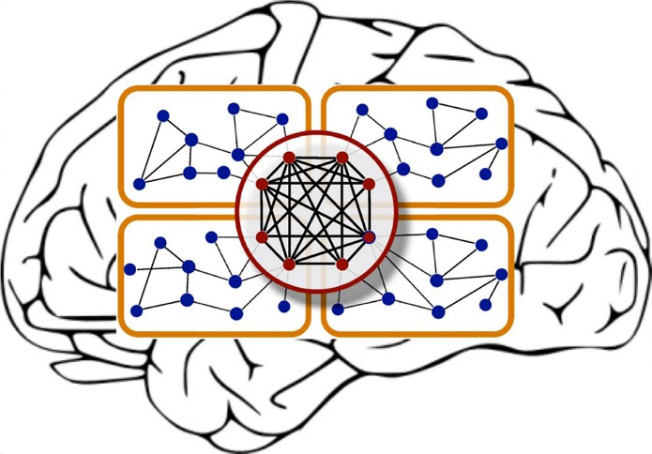
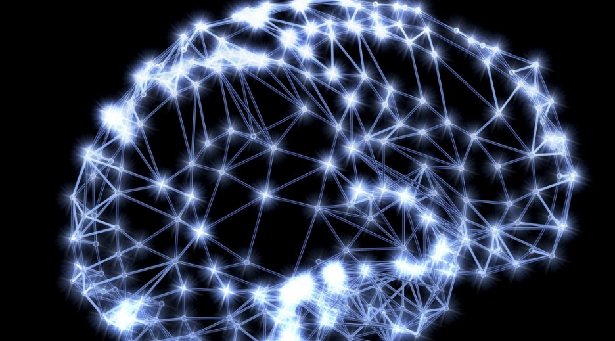
Neural Networks
Also called artificial neural networks (ANN)
Used for classification and prediction
Mimics human neurons and the way that human experts learn
Neurons are interconnected and learn from experience

Slide 3
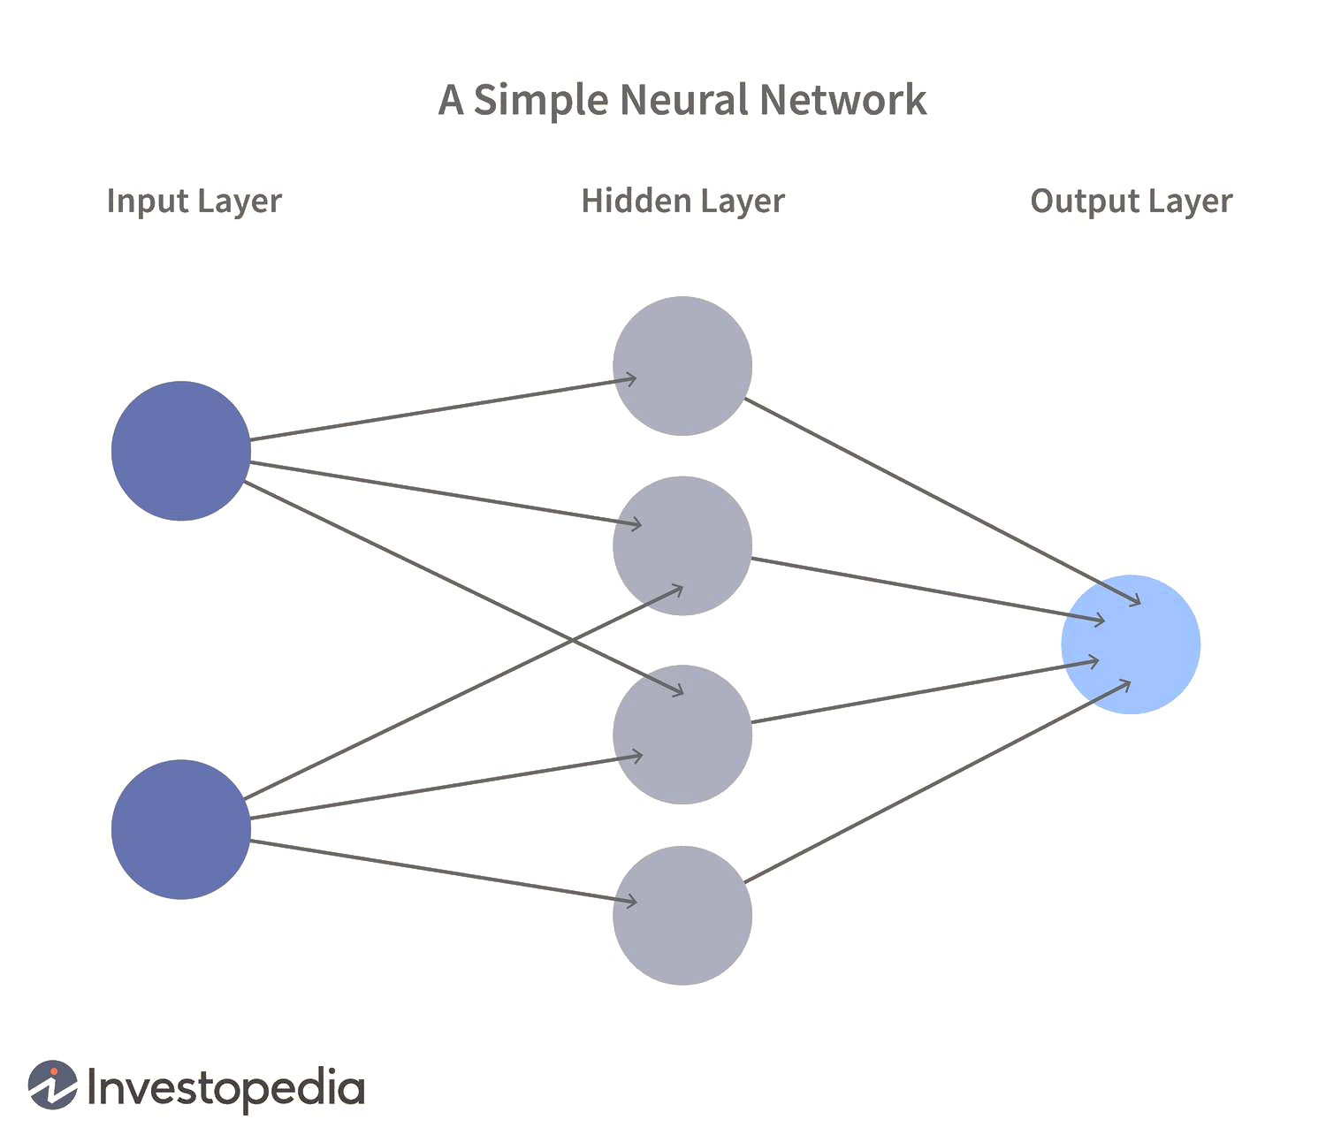
Schematic Diagram
Notes:
Nodes and layers

Slide 4
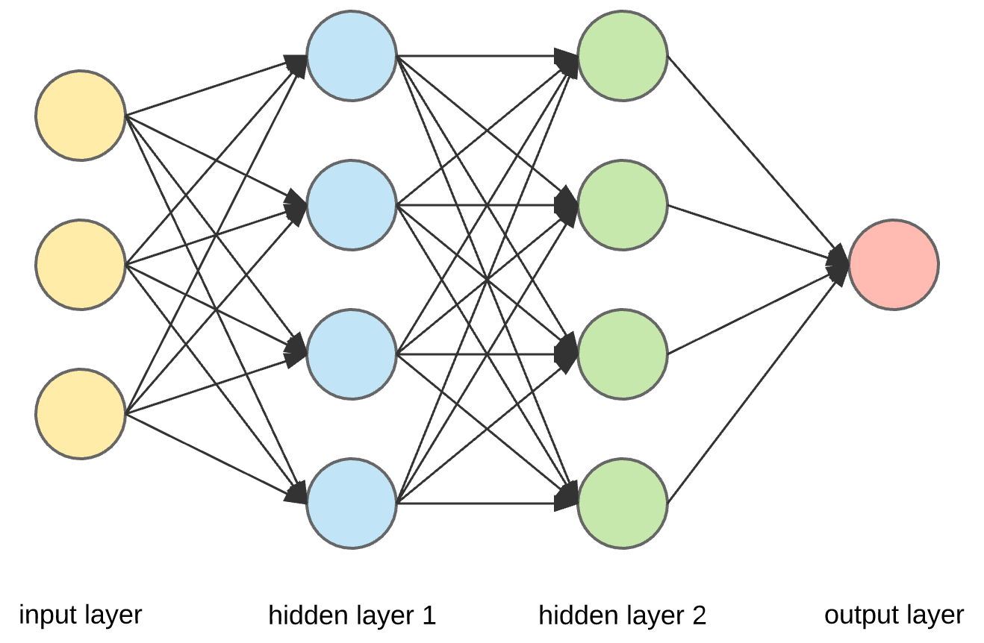
Schematic Diagram
Notes:
Nodes and layers

Slide 5
Neural Network: Activation Function
How to transform input to output:
Using a function called Activation Function or Transfer Function
We have two general types of activation function:
Linear functions
Non-linear functions
Notes:
Nodes and layers

Slide 6
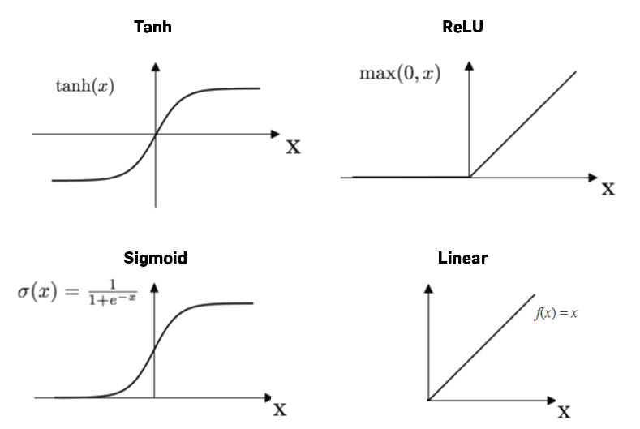
Neural Network: Activation Function
Notes:
Nodes and layers

Slide 7
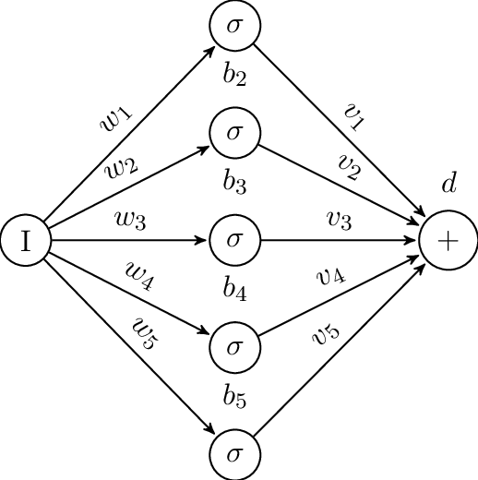
Network Structure
Multiple layers
Input layer (observations)
Hidden layers
Output layer
Weights (like coefficients, subject to iterative adjustment)
Bias values (like intercepts)
A constant that helps the activation function to shift in the positive or negative side

Slide 8
General Structure of NN
Training NN means learning the weights of the neurons
Notes:
Nodes and layers

Slide 9
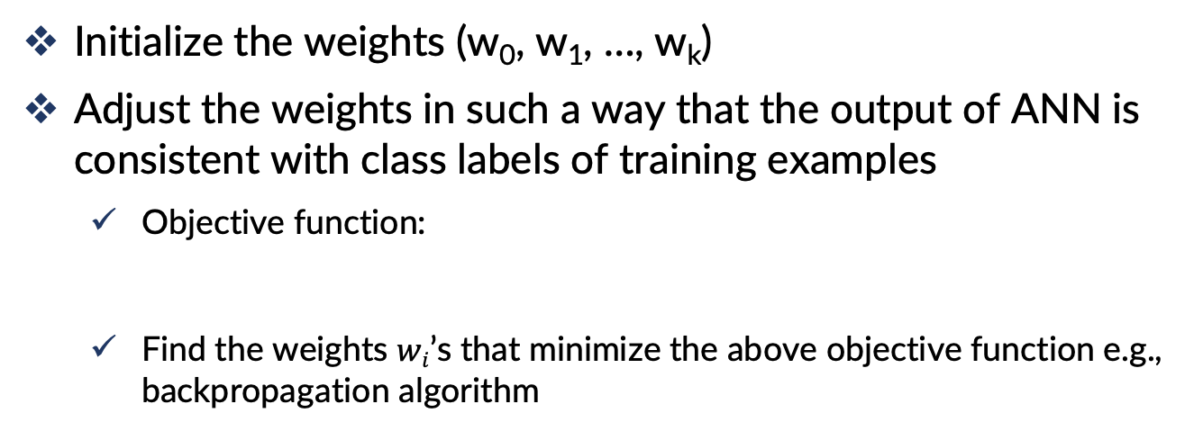
General Structure of NN
Initialize the weights (w₀, w₁, …, w_{k})
Adjust the weights in such a way that the output of ANN is consistent with class labels of training examples
Objective function:
Find the weights $wi$’s that minimize the above objective function e.g., backpropagation algorithm
Notes:
Nodes and layers

Slide 10
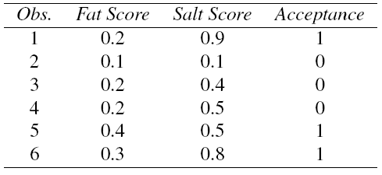
Example
Using fat & salt content to predict consumer acceptance of cheese

Slide 11
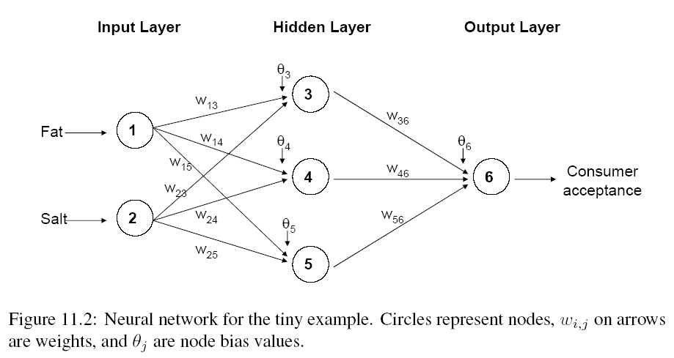
The Input Layer
For input layer, input = output
E.g., for record #1:
Fat input = output = 0.2
Salt input = output = 0.9
Output of input layer = input into hidden layer
0.2
0.2
0.9
0.9

Slide 12
The Hidden Layer
In this example, hidden layer has 3 nodes
Each node receives as input the output of all input nodes
Output of each hidden node is a function of the weighted sum of inputs
0.2
0.2
0.9
0.9

Slide 13
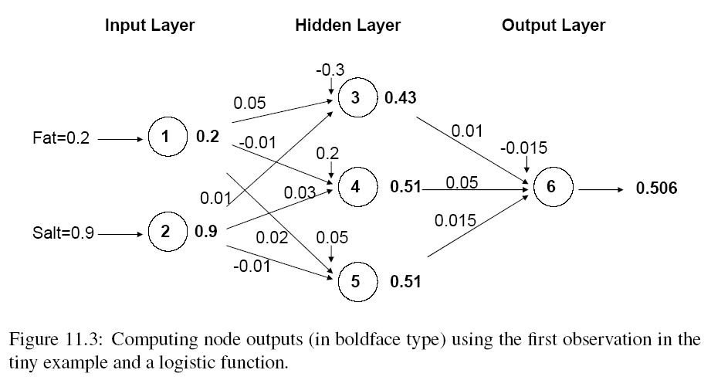
Output of Node 3, if g is a Logistic Function
θ₃
w₁₃
w₂₃

Slide 14
The Output Node

Slide 15
Mapping Output to Classification
Output = 0.506
If cutoff for class “1” is 0.5, then we classify as class “1”

Slide 16
Training the Model

Slide 17
Preprocessing Steps
Scale variables to 0-1
Transform (e.g., log) skewed variables

Slide 18
Weights
The weights w are typically initialized to random values in the range -0.05 to +0.05
These initial weights are used in the first round of training

Slide 19
Initial Pass-Through Network
Goal: Find weights that yield best predictions
The process we described in the simple example is repeated for all records
At each record, compare prediction to actual target value
Difference is the error for the output node
Error is propagated back and distributed to all the hidden nodes and used to update their weights

Slide 20
Initial Pass-Through Network

Slide 21
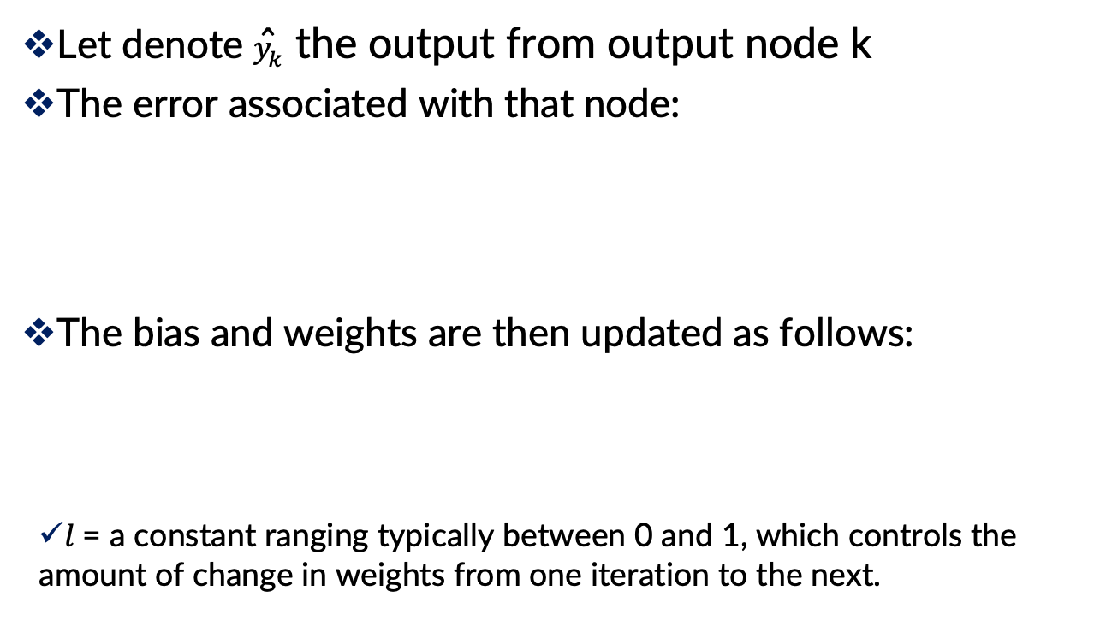
Back Propagation (“back-prop”)
Let denote ${\hat{y}}_{k}$ the output from output node k
The error associated with that node:
The bias and weights are then updated as follows:
$l$ = a constant ranging typically between 0 and 1, which controls the amount of change in weights from one iteration to the next.

Slide 22
Updating Methods
Two updating methods:
Case updating
The parameter values are updated after each record is run through the network
Batch updating
The entire training set is run through the network before each updating of the bias and weights takes place
In practice, case updating tends to yield more accurate results than batch updating but requires a longer run time.

Slide 23
When Does the Updating Stop?
1. When the new values of the bias and weights are only incrementally different from those of the preceding iteration
2. When the misclassification rate reaches a required threshold
3. When the limit on the number of runs is reached

Slide 24
Avoiding Overfitting
With sufficient iterations, neural net can easily overfit the data
To avoid overfitting:
Track error in validation data
Limit iterations
Limit complexity of network

Slide 25
Advantages
Good predictive ability
Can capture complex relationships
No need to specify a model

Slide 26
Disadvantages
Considered a “black box” prediction machine, with no insight into relationships between predictors and outcome
Heavy computational requirements if there are many variables (additional variables dramatically increase the number of weights to calculate)

